Slide 1
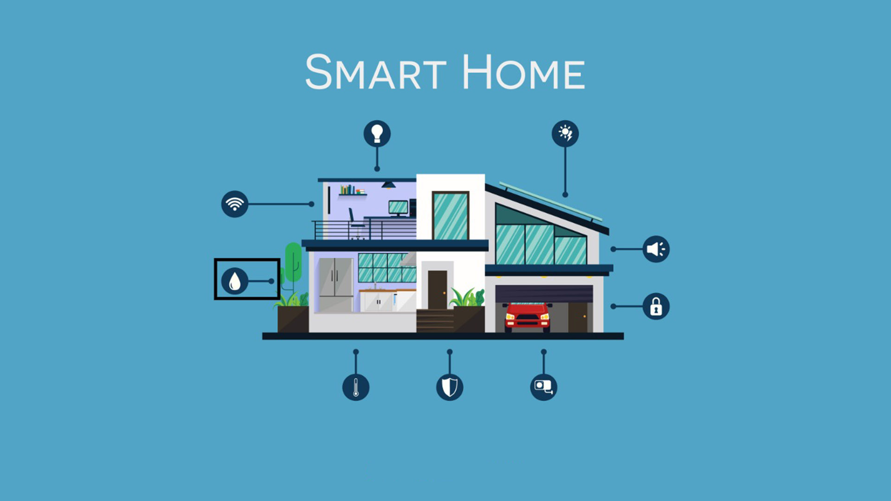
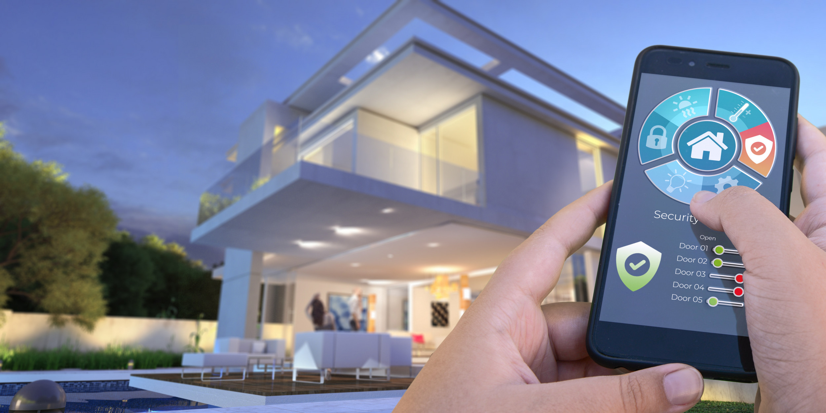
Smart Home
Group6
Su Myat Myat Htay (p2234951)
Ei Kyar Phyu (p2235105)

Slide 2
Agenda
1
2
3
4
5
Problem
Statement
Timeline+ Persona
Purpose Of
Our Project
Project Function
Project Sketch + diagrams

Slide 3
Have you ever forgot to turn off your aircon?

Slide 4
Have you ever wondered how many hours did you use your air conditioner a day
for?

Slide 5
Have you ever scare that someone will break into your house?

Slide 6





Plan for product launch
Research
Research on the problem statement
Conducting Interviews
Conducting interviews to get to know more about user needs and concern .
Proposed Solution
Brainstorm functions to fulfill user needs.
Implementing
Coding and debugging for our project
Launch
Deploy and showcase our project

Slide 7
Timeline
May 2023
Research on the problem statement
June 2023
Brainstorm functions to fulfill user needs.
August 2023
Deploy and showcase our project
May 2023
Conducting interviews to get to know more about user needs and concern .
July 2023
Coding and debugging for our project

Slide 8
Have you ever forgot to turn off your lights and aircon?
Have you ever wondered how many hours did you use your air conditioner
for?
Have you ever scare that someone will break into your house?

Slide 9
Problem Statement
Energy Inefficiency
Home Security Vulnerabilities

Slide 10
Energy Inefficiency

Slide 11
Do You Know?!

Slide 12
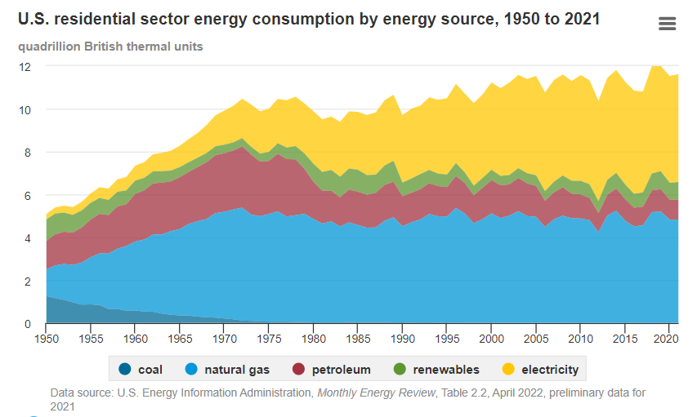
The average electricity consumption has an increase in decent amount for every ten years.

Slide 13
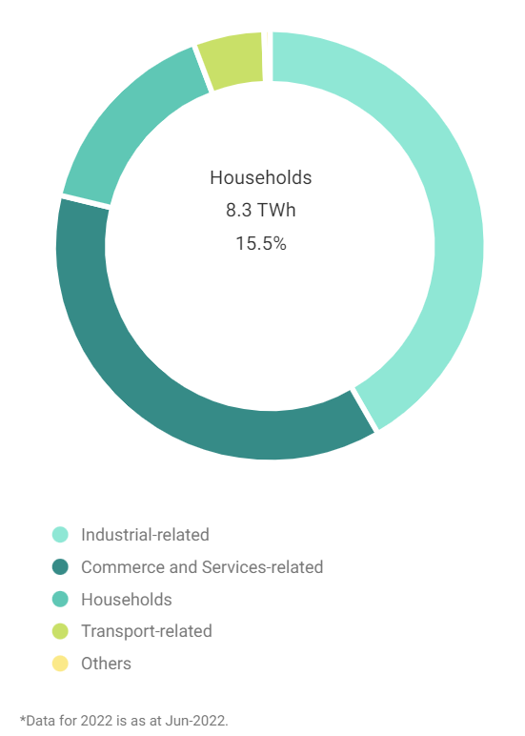
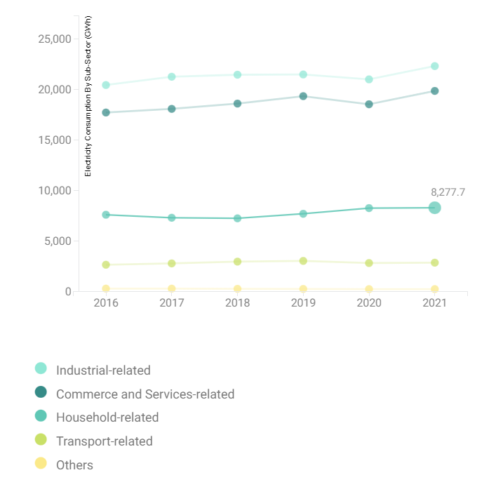
Based on the data collected by ema.gov.sg,
8.3% of the electricity usage are for households, which is 8277.7 GWh in Singapore

Slide 14
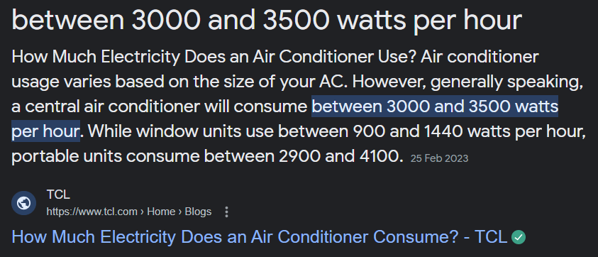
Ten hours of aircon will consume around 30kWh.

Slide 15
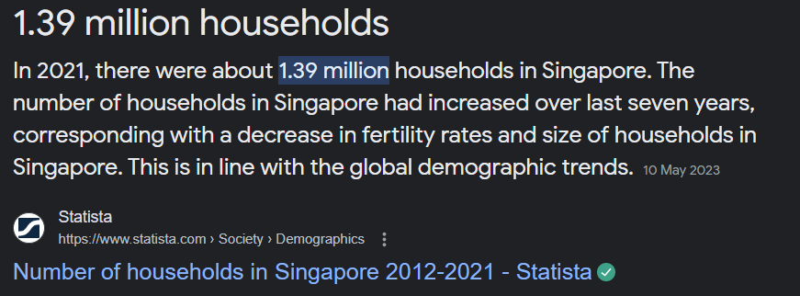
That is only for one household. Think about the country-wise.

Slide 16
Home Security Vulnerabilities

Slide 17
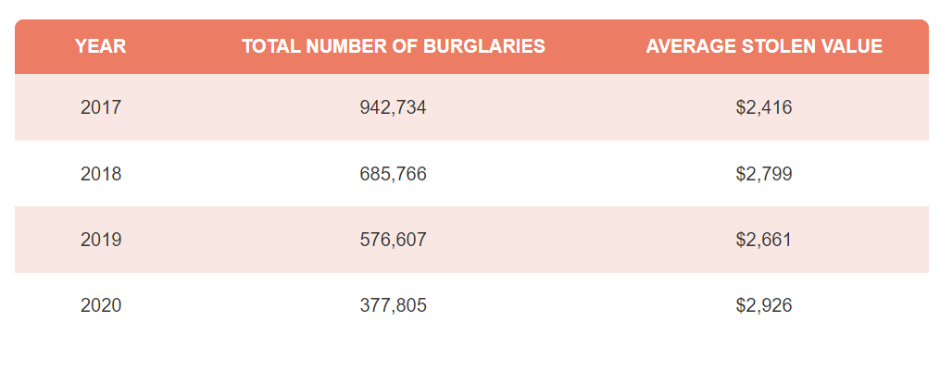
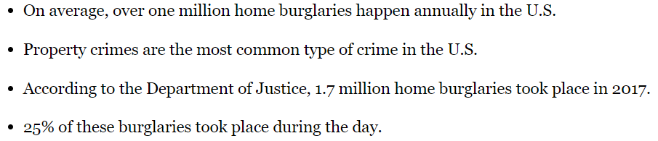
Data provided by Forbes.

Slide 18
Based on Access Residential Houseware. 70% of people have left their houses without remembering whether or not they locked the door. Another 60% of respondents reported that they have come home to find an unlocked door.

Slide 19
Almost 30% of burglars enter homes through an unlocked door. Approximately 34% of burglars gain access through the front door.
Locking your exterior doors is critical when it comes to security.

Slide 20
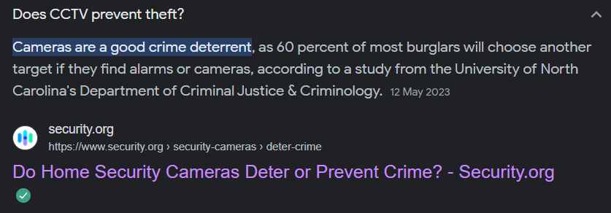
Do CCTVs can prevent thefts?

Slide 21
Conducting Interview

Slide 22

Interview Summary
Name : Ms. Daya
Ms. Daya mentions that she has a problem with flat mates relating to the air con open hour, and she mentions that she got disappointed when she sees the front door is opened when she come back home with no one inside. For some months, she got surprised with the electricity bill, and she doubts that flat mates never turn off the air con even they are outside of house.

Slide 23
Persona
Name : Ms. Scarlett
Ms.Scarlett is the 45 years old Singaporean, who is currently renting rooms in her house for her monthly income. She is not a strict landlord, and she wants to give full privacy to her tenants. She made an agreement with her tenants not to use air conditioner more than 12 hours a day and to switch off the lights when it is not necessary. As she is the type of person who always care about privacy and security, she wants the front door to be locked when there is no one at home.

Slide 24
2 x 2 Matrix for Idea Selection
High Impact
A - Home Smart Automation
B - Real-time Traffic Analysis
C - Smart Pet Feeder
D - Home Weather Station
B
A (Selected
For implementation)
Low
Feasibility
High
Feasibility
C D
Low Impact

Slide 25
Purpose Of Our Project
Convenience and Time Savings
Peace of mind
Enhanced Security and Safety
Energy Efficiency and Cost Savings

Slide 26
Solutions
Smart Lock with face ID
Air conditioners
Humidifiers

Slide 27
Smart Lock with face ID
Functions
Our smart lock uses facial recognition technology.
The users simply approach the door, and the facial recognition system identifies and verifies their face with seconds

Slide 28
Smart Lock with face ID
Advantages
convenience and speed
a high level of security

Slide 29
Air conditioners
Functions
Users can control air conditioners even when they are not physically present.
Our application will notify the users daily after they have used the limited time. The duration is flexible. The users can change it by themselves.
Our application will also display the usage time of air conditioners during the current month with bar chart.

Slide 30
Air conditioners
Advantages
Energy management
Transparent Billing
By tracking the total time of air conditioner usage for each room, homeowners
can provide accurate and transparent billing to their tenants.

Slide 31
Humidifiers
Functions
Our application receives the humidity data from the sensor and analyze it to
determine whether the humidity levels are within the desired range.
If the humidity exceeds the desired range, our application will turn off humidifiers
automatically.

Slide 32
Humidifiers
Advantages
Optimal Indoor Comfort
Mold Prevention
Health and well-beings

Slide 33
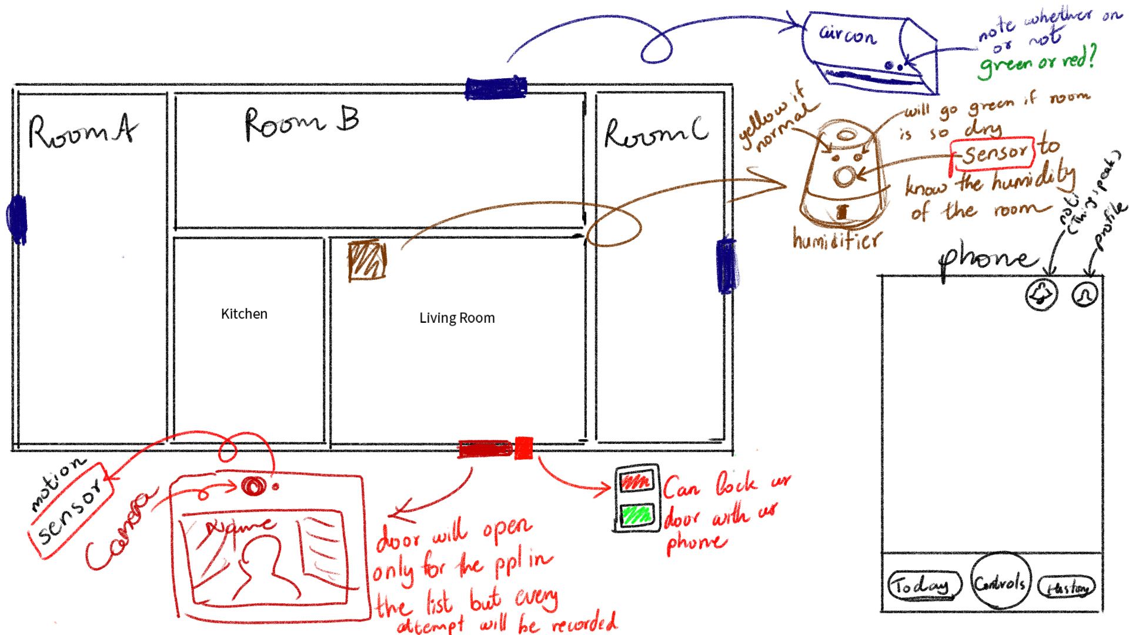
Concept Sketch

Slide 34
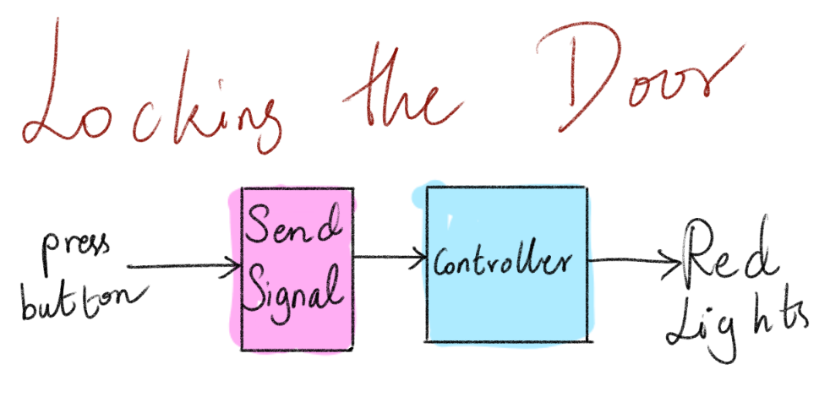
Block Diagram (Locking)

Slide 35
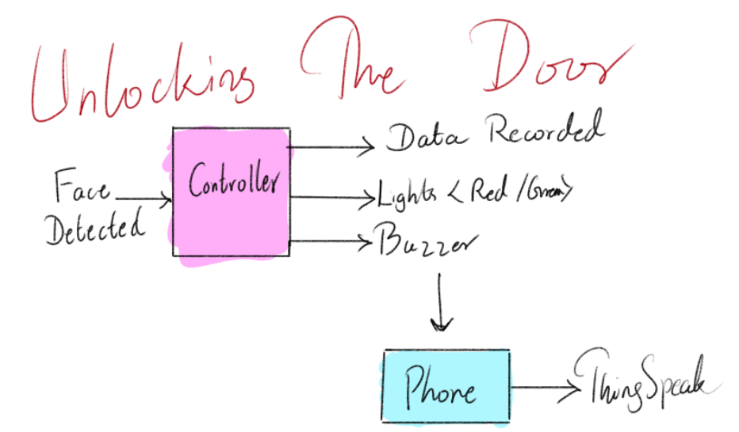
Block Diagram (Unlocking)

Slide 36
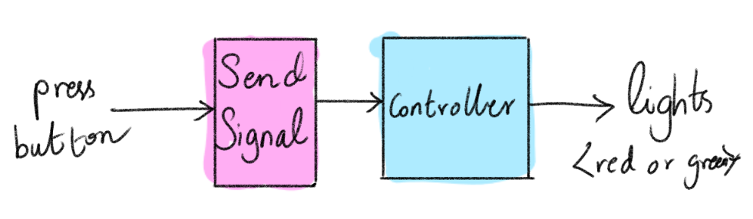
Block Diagram (Air Conditioning)

Slide 37
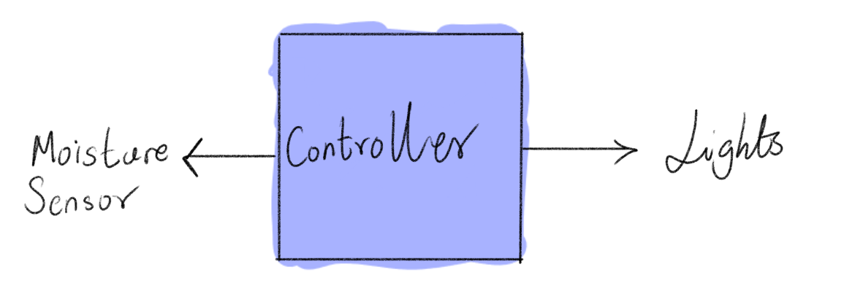
Block Diagram (Humidifier)

Slide 38
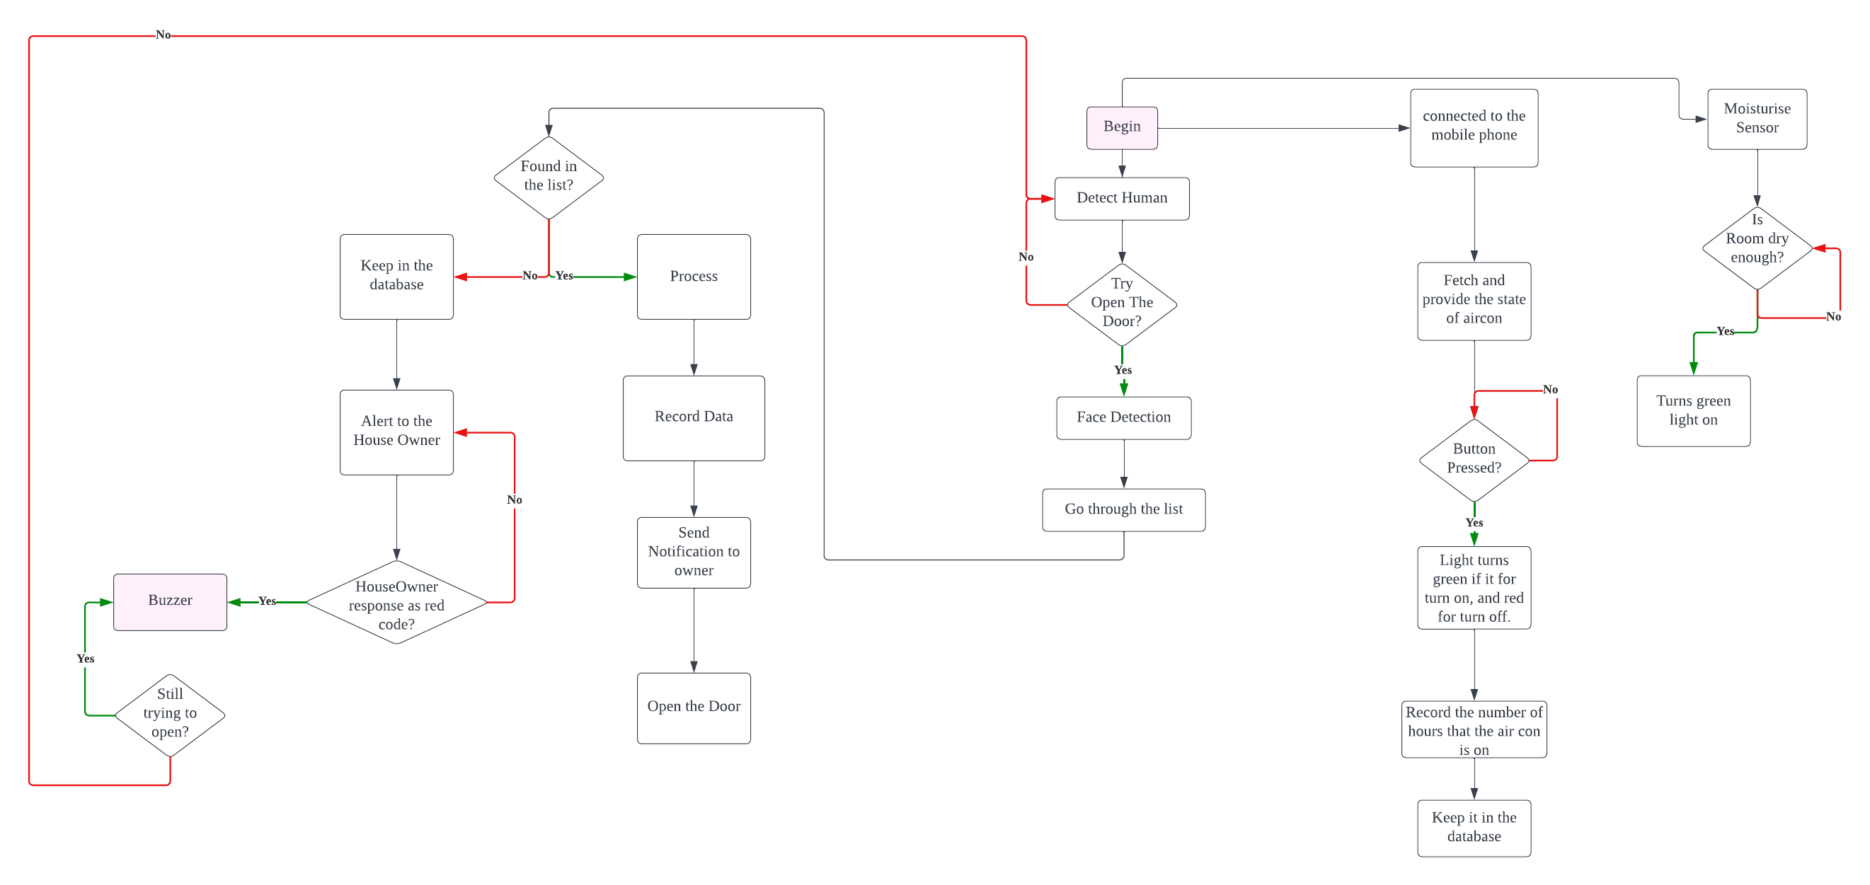
Flowchart

Slide 39
Dataflow for Smart Lock
sensor
Face Recognition and Verification
Lock control
Status

Slide 40
Dataflow for Air Conditioners
Calculate total time daily and monthly
Data concentrator
Smartphone
monthly
daily
Bar chart
notification

Slide 41
Dataflow for Humidifier
Humidity sensor
Data Concentrator
Data Analysis
Humidifier Status Update

Slide 42
Gantt Chart
Project tasks | Week 10-11 | Week 12-14 | Week 15-16 | Week 17
Assign task to members
Set up
Smart Lock
Air Conditions
Humidifiers
Testing/Debugging

Slide 43
Conclusion
Our application is all about smart home automation application.
All the features in our application solve the problems as mentioned above.
They are also user-friendly and offer numerous benefits for homeowners.
By using our application, homeowners can create a more convenient, efficient, and secure living environment.

Slide 44
Thank you

